Slide 1
CodeNEXT
Nonconforming defined in R2C zones (and a bit about SF in RM)
Heritage Neighborhood
Prepared by Jolene Kiolbassa

Slide 2
Non-conforming & non-complying
Means structure or use does not conform or comply with current code
Definitions are generally interchangeable
“Nonconforming” is the term used in CodeNEXT

Slide 3
CodeNEXT defines for R2C
Lot sizes and widths
Structure placement
Pool placement
Carport placement
Structure height
Top plate (i.e. bottom of roof line) height, meaning it specifies height of stories

Slide 4
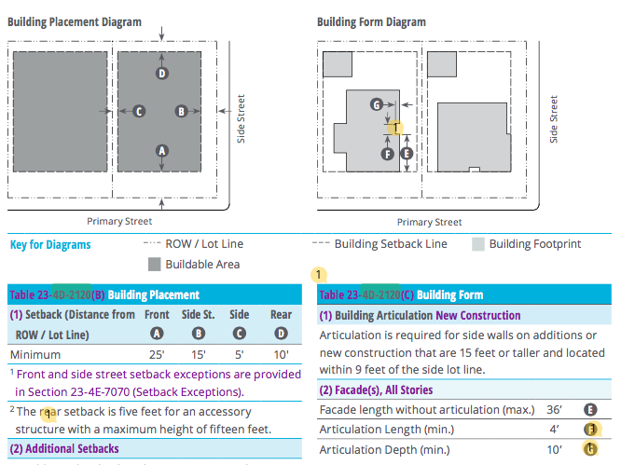
R2C setbacks and articulation

Slide 5
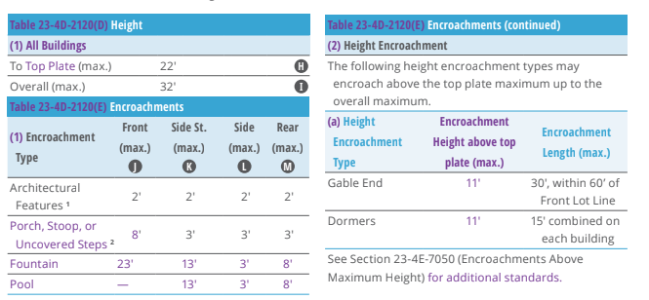
R2C heights

Slide 6
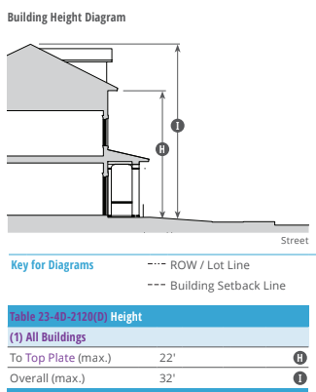
“Top plate” and height illustrated

Slide 7
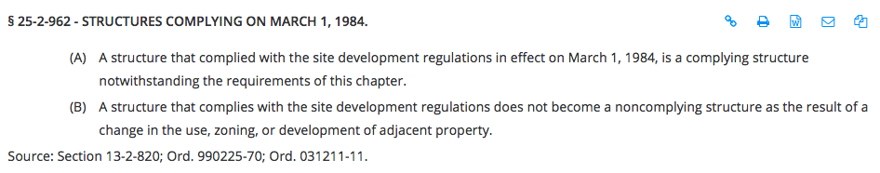
Grandfathering of structures
Current code explicitly grandfathers non-complying structures from the previous code

Slide 8
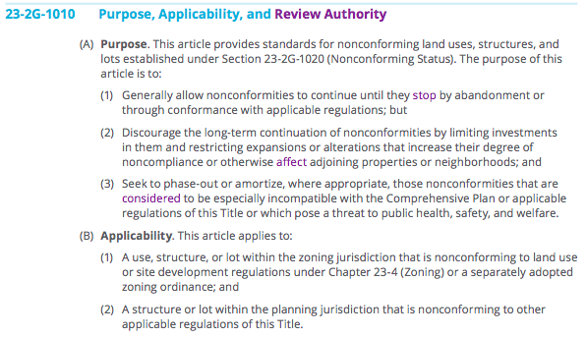
CodeNEXT explicitly does not grandfather

Slide 9
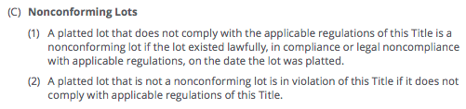
CodeNEXT explicitly says lots will be nonconforming

Slide 10
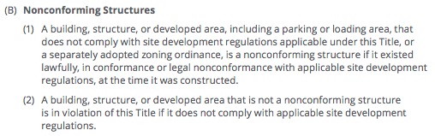
CodeNEXT explicitly says structures will be nonconforming

Slide 11
If your house is zoned R2C and is
Within 5 ft. of your neighbor’s property line
Within 15 ft. of a side street
Within 25 ft. of the front property line (sidewalk)
Within 10 ft. of the back property lot
Has a top plate that is higher than 22 ft.
Is taller than 32 ft.
It will be nonconforming under CodeNEXT

Slide 12
If your house has a swimming pool that is
In front of the house
Less than 13 ft. from a side street
Less than 8 ft. from the back property line
Less than 3 ft. from the side property line
It will be nonconforming under CodeNEXT

Slide 13
If your lot size is
Less than 5,000 sq. ft.
Is less than 2,500 sq. ft. and you are in an “attached house”
It will be nonconforming under CodeNEXT

Slide 14
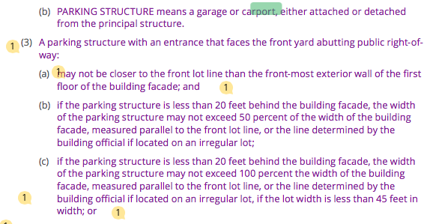
If your house has a carport, it cannot be closer to the street than the front of the house, you will need to get rid of the carport or be nonconforming

Slide 15
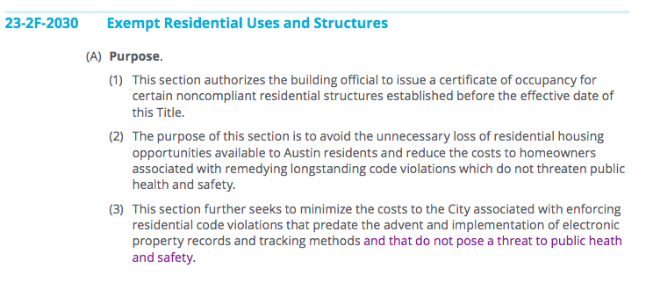
If your house is nonconforming you will need to apply for a Certificate of Occupancy (CO) and include “supporting documentation”

Slide 16
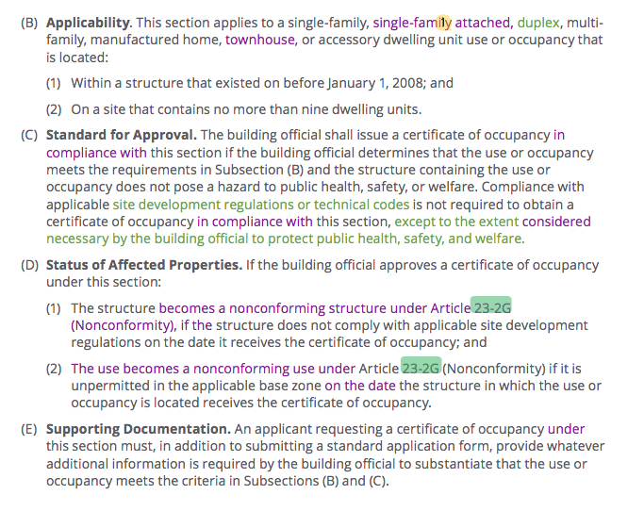

Slide 17
Legal Interpretation of Previous Slide
* It gives an extraordinary amount of discretion to "building officials" to determine whether a structure poses a hazard to "public health, safety and welfare." This is about as broad a standard as could be articulated and is guaranteed to produce arbitrary decisions -- with those with influence and resources being given a break and those who do not being given a hard time.
* It is almost identical to the standard assigned to municipalities in developing their zoning regulations: Texas Loc. Gov't Code Sec. 211.001: "The powers granted under this subchapter are for the purpose of promoting the public health, safety, morals, or general welfare...."
* There could be an argument made that this is an unlawful delegation to an individual city employee by the City Council of authority granted to the City Council by the Texas Legislature.

Slide 18
Adding to or repairing a nonconforming structure
Becomes very difficult
Is prescriptive
May depend on a calculation of cost of addition versus cost of structure

Slide 19
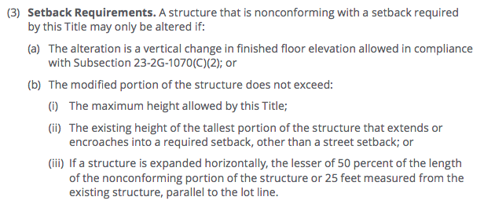
Adding to a structure that does not comply with setbacks

Slide 20
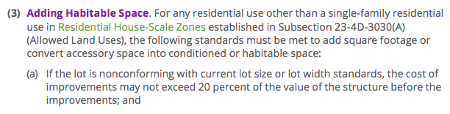
Adding to a nonconforming RM (currently MF) building or a SF house in a RM zone becomes almost impossible

Slide 21
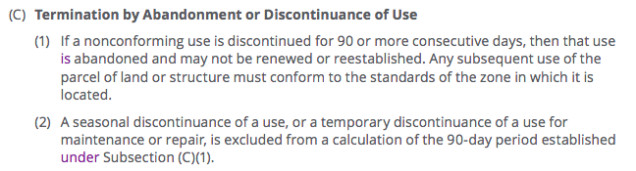
23-2G-1060 If a nonconforming property (including houses) is vacant for 90 days it can no longer be a house

Slide 22
City Legal’s Explanation
Re current uses/structures becoming nonconforming:
The 1984 Code revision contained a “safe harbor” provision to ensure the new code did not inadvertently make existing lawful uses and structures nonconforming, thus placing an undue burden on the owner. Staff recommends eliminating this so-called “safe harbor” approach in CodeNEXT “because it adds unneeded complexity to the review process and may have the effect of exempting certain properties from rules limiting the expansion or modification of uses and structures that don’t comply with regulations. Additionally, because CodeNEXT generally allows nonconformities to continue and be maintained, a “safe harbor” provision is not necessary to protect landowner rights.” (Legal & Administrative Overview, October 11, 2017).

Slide 23
My interpretation of City Legal’s interpretation
1984 provision to grandfather was bad idea
Pointedly will not include 1984 provision again
Repeats idea previously asserted by staff that CodeNEXT does not create many nonconforming properties, which staff can only state if it surveys properties or tests the code in older neighborhoods
No survey has been done of how many properties will be made nonconforming so City Legal can make any assertions

Slide 24
Neighborhood Plans
In Neighborhood Plans nonconforming properties were made conforming/complying
If house on SF zoning was previously converted to duplex or apartment, NP changed zoning to fit what was on the ground
CodeNEXT takes opposite stance and changes zoning to be at odds with what is on the ground

Slide 25
Impact on older neighborhoods
Creates many non-conforming properties
Lower income less likely to get COs so will be forced to sell
Others will not be able to improve or add to homes
Loss of already paid-for affordable housing stock
Eventual loss of older neighborhoods

Slide 26
What next?
Commercial and multi-family zones also affected by overly prescriptive rules
Minimums and maximums on front setbacks will make many buildings non-complying
Height, building coverage, impervious cover and parking placement also specified
Some commercial properties will not be grandfathered*
*Research and presentation in the works

